Slide 1
SWE4005- Storage Technology and Management
Direct Attached Storage and Introduction to SCSI

Slide 2
Chapter Objective
Upon completion of this chapter, you will be able to:
Discuss the benefits and challenges of DAS
Discuss DAS management options
Discuss evolution of SCSI
Describe SCSI – 3 architecture
Discuss SCSI addressing and communication model

Slide 3
Host Access to Data
Data is accessed and stored by applications using the underlying infrastructure.
The key components of this infrastructure are the operating system (or file system), connectivity, and storage.
The storage device can be internal and (or) external to the host.
Host controller card accesses the storage devices using predefined protocols, such as IDE/ATA, SCSI, or Fibre Channel (FC).
External storage devices can be connected to the host directly or through the storage network.
When the storage is connected directly to the host, it is referred as direct-attached storage (DAS)

Slide 4
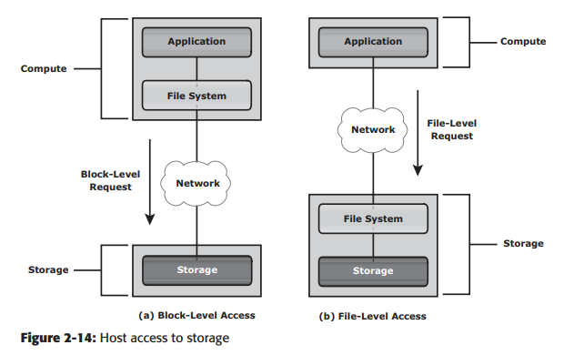
Data access
Data can be accessed over a network in one of the following ways:
block level,
file level, or object level.

Slide 5
Direct Attached Storage
Upon completion of this lesson, you will be able to:
Discuss the benefits of DAS
Describe the elements of DAS
Discuss DAS management considerations
Discuss DAS challenges

Slide 6
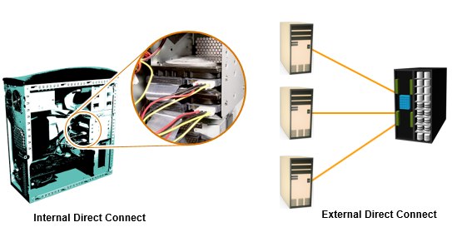
What is DAS?

Slide 7
DAS Benefits
Ideal for local data provisioning
Quick deployment for small environments
Simple to deploy
Low capital expense
Low complexity

Slide 8
DAS Connectivity Options
ATA (IDE) and SATA
Primarily for internal bus
SCSI
Parallel (primarily for internal bus)
Serial (external bus)
FC
High speed network technology

Slide 9
DAS Management
Internal
Host provides:
Disk partitioning (Volume management)
File system layout
Direct Attached Storage managed individually through the server and the OS
External
Array based management
Lower TCO (Total Cost of Ownership) for managing data and storage Infrastructure

Slide 10
DAS Challenges
Scalability is limited
Number of connectivity ports to hosts
Difficulty to add more capacity
Limited bandwidth
Distance limitations
Downtime required for maintenance with internal DAS
Limited ability to share resources
Array front-end port
Unused resources cannot be easily re-allocated
Resulting in islands of over and under utilized storage pools

Slide 11
Introduction to SCSI
Upon completion of this module, you will be able to:
Describe SCSI-3 architecture
Discuss SCSI device models with different port configurations
Describe SCSI Addressing
Notes:
https://www.youtube.com/watch?v=A3q1x3_7tTg

Slide 12
Evolution of Parallel SCSI
Developed by Shugart Associates & named as SASI (Shugart Associates System Interface)
ANSI acknowledged SCSI as an industry standard
SCSI versions
SCSI–1
Defined cable length, signaling characteristics, commands & transfer modes
Used 8-bit narrow bus with maximum data transfer rate of 5 MB/s
SCSI–2
Defined Common Command Set (CCS) to address non-standard implementation of the original SCSI
Improved performance, reliability, and added additional features
SCSI–3
Latest version of SCSI

Slide 13
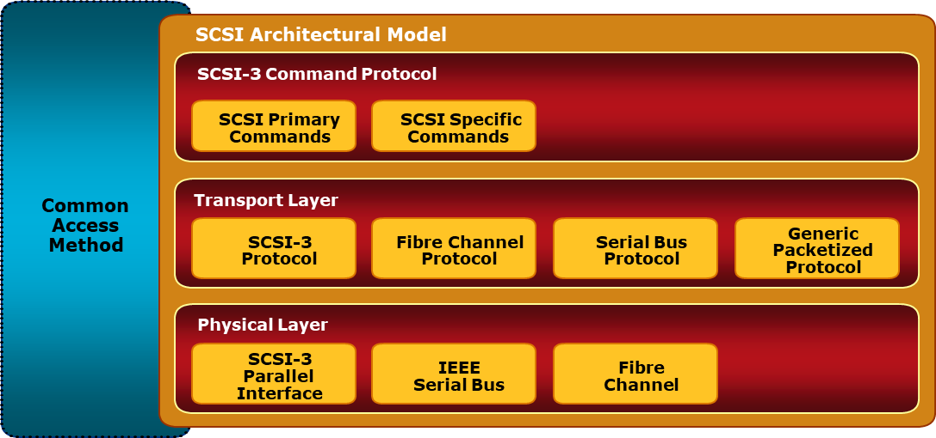
SCCI Architecture
SCSI command protocol
Primary commands common to all devices
Transport layer protocol
Standard rules for device communication and information sharing
Physical layer interconnect
Interface details such as electrical signaling methods and data transfer modes

Slide 14
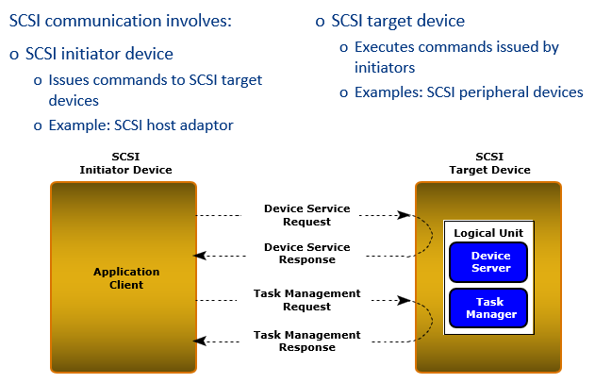
SCSI Device Model

Slide 15
Device requests uses Command Descriptor Block (CDB)
8 bit structure
Contain operation code, command specific parameter and control parameter
SCSI Ports
SCSI device may contain initiator port, target port, target/initiator port
Based on the port combination, a SCSI device can be classified as an initiator model, a target model, a target model with multiple ports or a combined model (target/initiator model). Example:
Target/initiator device contain target/initiator port and can switch orientations depending on the role it plays while participating in an I/O operation
To cater to service requests from multiple devices, a SCSI device may also have multiple ports (e.g. target model with multiple ports)

Slide 16
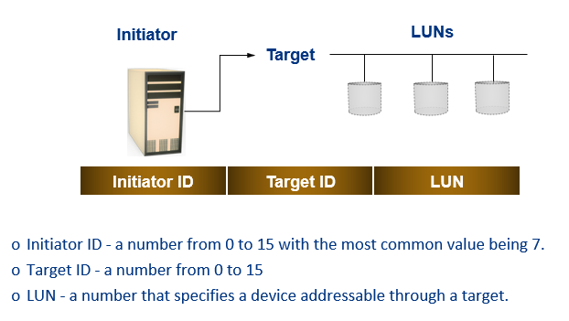
SCSI ADDRESSING
Notes:
Ctd- controller/ target/device

Slide 17
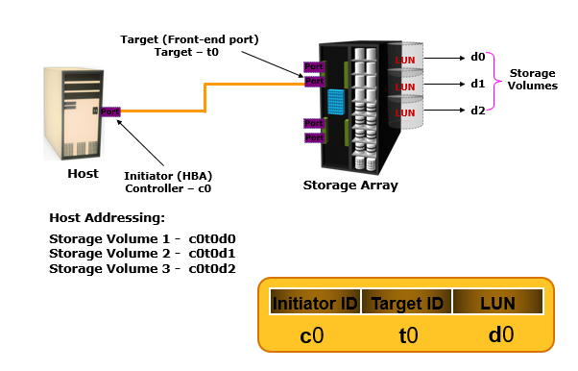
Example

